Slide 1
The video for this presentation can be found here

Slide 2
Connect(); // 2017

Slide 3
Intelligent Edge + Intelligent Cloud

Slide 4
Any developer Any app Any platform

Slide 5
VISUAL STUDIO
ASP.NET
AZURE LINUX VM
VISUAL STUDIO CODE
C#
iOS DEVICE
Any developer Any app Any platform
XAMARIN STUDIO
C++
AZURE WINDOWS VM
EMACS
NODE.JS
ANDROID DEVICE
VIM
PYTHON
AZURE CONTAINER SERVICE
VISUAL STUDIO
HTML/JS
WINDOWS DEVICE
VISUAL STUDIO CODE
ASP.NET
AZURE WEB APP
VISUAL STUDIO MAC
C#
AZURE LINUX VM
EMACS
C++
iOS
DEVICE
VIM
NODE.JS
AZURE WINDOWS VM
PYTHON
ANDROID DEVICE
HTML/JS
AZURE CONTAINER SERVICE
WINDOWS DEVICE
AZURE WEB APP

Slide 6
ASP.NET
AZURE LINUX VM
VISUAL STUDIO
C#
iOS DEVICE
VISUAL STUDIO CODE
C++
AZURE WINDOWS VM
XAMARIN STUDIO
NODE.JS
ANDROID DEVICE
EMACS
PYTHON
AZURE CONTAINER SERVICE
VIM
HTML/JS
WINDOWS DEVICE
VISUAL STUDIO
ASP.NET
AZURE WEB APP
VISUAL STUDIO
ASP.NET
AZURE WEB APP
Any developer Any app Any platform
VISUAL STUDIO CODE
C#
AZURE LINUX VM
VISUAL STUDIO MAC
C++
iOS
DEVICE
EMACS
NODE.JS
AZURE WINDOWS VM
VIM
PYTHON
ANDROID DEVICE
HTML/JS
AZURE CONTAINER SERVICE
WINDOWS DEVICE
AZURE WEB APP

Slide 7
VISUAL STUDIO
AZURE LINUX VM
VISUAL STUDIO CODE
iOS DEVICE
XAMARIN STUDIO
AZURE WINDOWS VM
EMACS
ASP.NET
ANDROID DEVICE
VIM
C#
AZURE CONTAINER SERVICE
VISUAL STUDIO
C++
WINDOWS DEVICE
VISUAL STUDIO
CODE
NODE.JS
AZURE WEB APP
VISUAL STUDIO CODE
NODE.JS
AZURE WEB APP
Any developer Any app Any platform
VISUAL STUDIO MAC
PYTHON
AZURE LINUX VM
EMACS
HTML/JS
iOS
DEVICE
VIM
ASP.NET
AZURE WINDOWS VM
C#
ANDROID DEVICE
C++
AZURE CONTAINER SERVICE
NODE.JS
WINDOWS DEVICE
PYTHON
AZURE WEB APP
HTML/JS

Slide 8
VISUAL STUDIO
AZURE LINUX VM
VISUAL STUDIO CODE
iOS DEVICE
XAMARIN STUDIO
AZURE WINDOWS VM
EMACS
ASP.NET
ANDROID DEVICE
VIM
C#
AZURE CONTAINER SERVICE
VISUAL STUDIO
C++
WINDOWS DEVICE
VISUAL STUDIO
C++
WINDOWS DEVICE
Any developer Any app Any platform
VISUAL STUDIO CODE
NODE.JS
AZURE WEB APP
VISUAL STUDIO MAC
PYTHON
AZURE LINUX VM
EMACS
HTML/JS
iOS
DEVICE
VIM
ASP.NET
AZURE WINDOWS VM
C#
ANDROID DEVICE
C++
AZURE CONTAINER SERVICE
NODE.JS
WINDOWS DEVICE
PYTHON
AZURE WEB APP
HTML/JS

Slide 9
AZURE LINUX VM
VISUAL STUDIO
ASP.NET
iOS DEVICE
VISUAL STUDIO CODE
C#
AZURE WINDOWS VM
XAMARIN STUDIO
C++
ANDROID DEVICE
EMACS
NODE.JS
AZURE CONTAINER SERVICE
VIM
PYTHON
WINDOWS DEVICE
VISUAL STUDIO
HTML/JS
AZURE WEB APP
VISUAL STUDIO CODE
ASP.NET
AZURE LINUX VM
VISUAL STUDIO MAC
C#
iOS DEVICE
VISUAL STUDIO MAC
C#
iOS
DEVICE
Any developer Any app Any platform
EMACS
C++
AZURE WINDOWS VM
VIM
NODE.JS
ANDROID DEVICE
PYTHON
AZURE CONTAINER SERVICE
HTML/JS
WINDOWS DEVICE
AZURE WEB APP

Slide 10
AZURE LINUX VM
iOS DEVICE
AZURE WINDOWS VM
VISUAL STUDIO
ASP.NET
ANDROID DEVICE
VISUAL STUDIO CODE
C#
AZURE CONTAINER SERVICE
XAMARIN STUDIO
C++
WINDOWS DEVICE
EMACS
NODE.JS
AZURE WEB APP
VIM
VIM
PYTHON
AZURE LINUX VM
PYTHON
AZURE LINUX VM
Any developer Any app Any platform
VISUAL STUDIO
HTML/JS
iOS
DEVICE
VISUAL STUDIO CODE
ASP.NET
AZURE WINDOWS VM
VISUAL STUDIO MAC
C#
ANDROID DEVICE
EMACS
C++
AZURE CONTAINER SERVICE
VIM
NODE.JS
WINDOWS DEVICE
PYTHON
AZURE WEB APP
HTML/JS

Slide 11

The Visual Studio Family
Microsoft Azure
Best-in-class tools for every developer

Slide 12

Visual Studio Code with Azure
Chris Dias
Amanda Silver
@chrisdias
@amandaksilver

Slide 13
NEW
Visual Studio Live Share
Real-time collaborative development
Shared debugging, independent views
Works across Visual Studio and Visual Studio Code

Slide 14
Intelligent Edge + Intelligent Cloud

Slide 15
Mobile
Mobile Containers
DevOps
Data
AI
Intelligent Edge + Intelligent Cloud

Slide 16
Mobile

Slide 17
Essentials for mobile success
Beautiful native apps
Build, test, distribute, learn
Intelligent cloud

Slide 18



















Visual Studio and Xamarin
Loved by developers, trusted by enterprise

Slide 19
Mobile App Development
James Montemagno
@jamesmontemagno

Slide 20
NEW
.NET Embedding in iOS + Android
Natively compile .NET code
Call from Swift, Objective-C + Java
Easily start with Xamarin in existing iOS and Android apps

Slide 21
Live Update
Crash Reporting
A/B Testing
Storage
Identity
Push Notifications
Remote Config.
Tables

Slide 22
Visual Studio App Center
Push Notifications
A/B Testing
Crash Reporting
Remote Config.
Identity
Continuous Everything – Build, Test, Deploy, Engage, Repeat.
Storage
Live Update
Tables
:-)

Slide 23


Slide 24
Visual Studio App Center
Simina Pasat
James Montemagno
@siminapasat
@jamesmontemangno

Slide 25
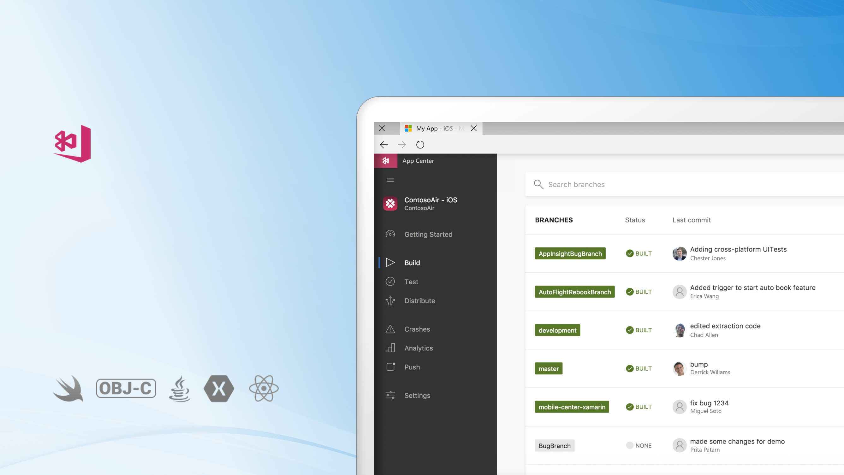
Visual Studio App Center
GENERAL AVAILABILITY
Continuous Everything. Build, Test, Deploy, Engage, Repeat.

Slide 26
Containers

Slide 27
Microservices + Containers
Azure Container Service (AKS)
Shopping Cart Service
.NET CORE
Catalog Service
JAVA
Inventory Service
RUBY
WEB APP
Shipping Service
.NET CORE
Account Service
PYTHON

Slide 28

Azure Container Services (AKS)
Fully managed Kubernetes orchestration service
Auto patching, auto scaling, auto updates
Use the full Kubernetes ecosystem
Azure and Azure Stack

Slide 29
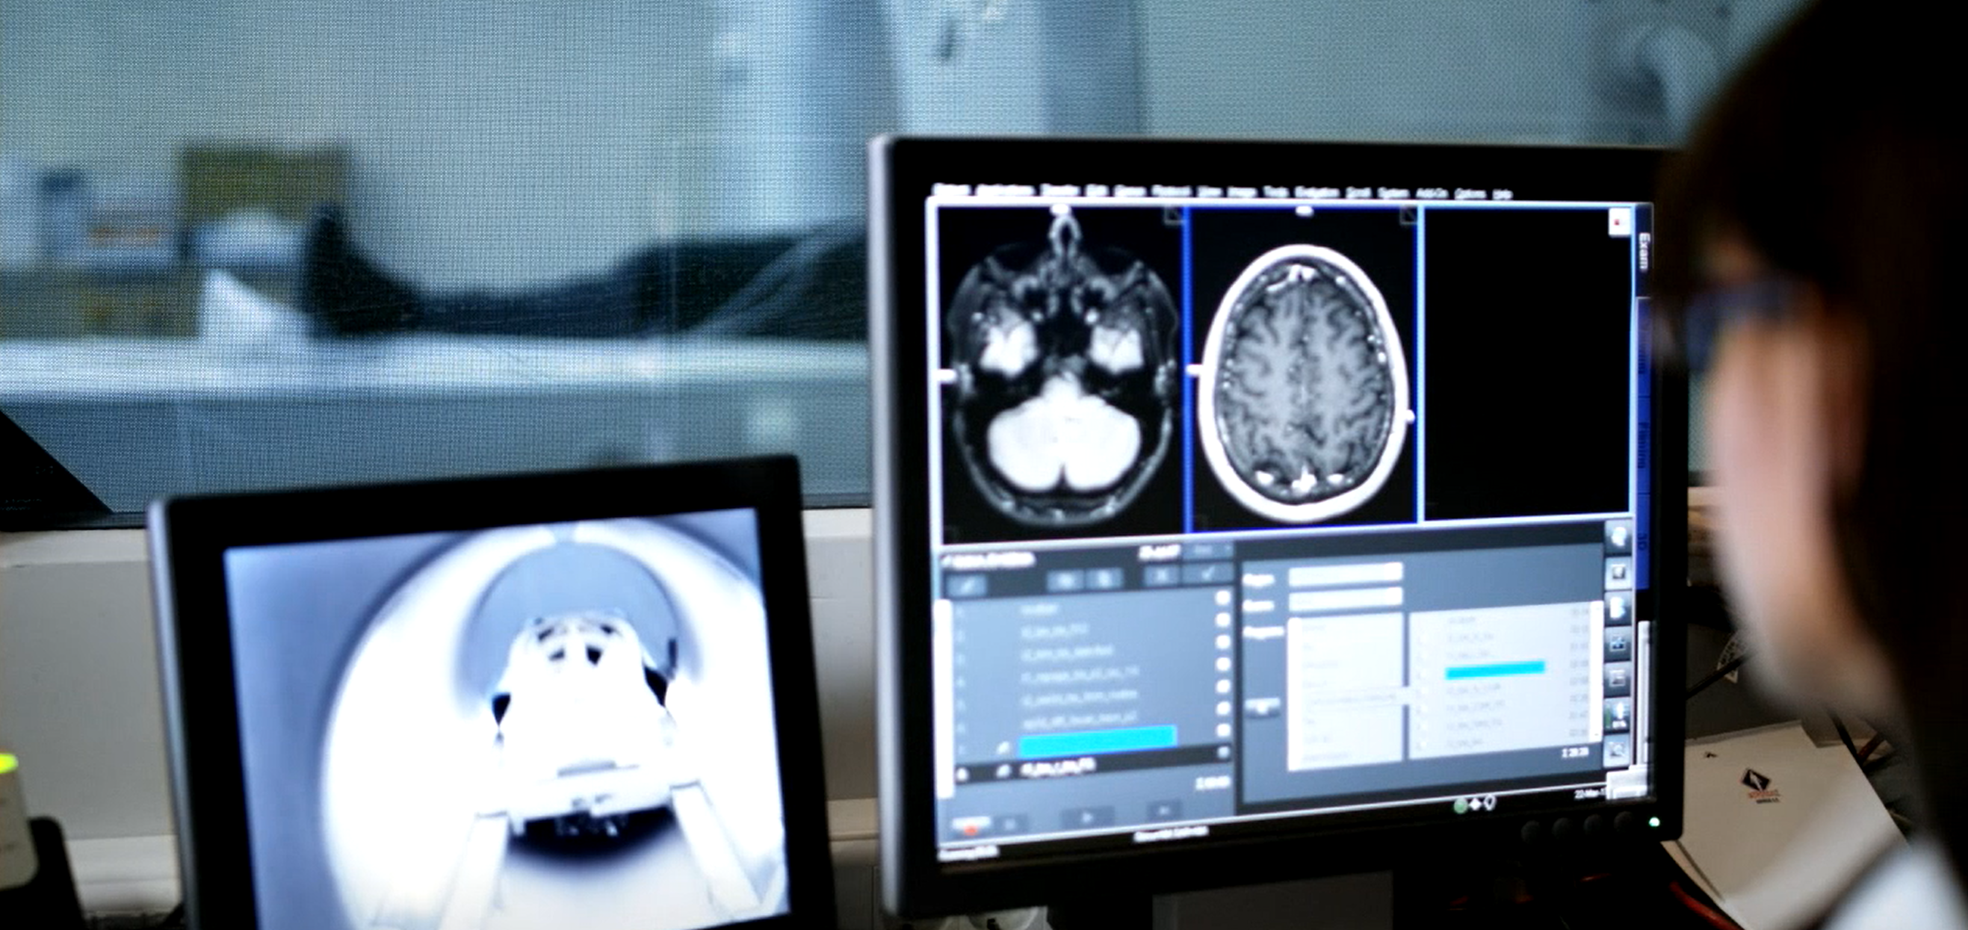


Slide 30
Inner-loop development with containers
Edit and deploy code instantaneously
Debug and set breakpoints across microservices
Seamlessly connect to cloud environments

Slide 31
Inner-loop development with containers
Scott Hanselman
@shanselman

Slide 32
NEW
Visual Studio Connected Environment for AKS
Inner-loop development with containers
Iteratively develop with speed on Kubernetes
Test in your team’s shared environment
Harness the power of open ecosystems

Slide 33
DevOps

Slide 34
Visual Studio Team Services
Complete DevOps solution
Code Repository
Build + Deploy
Test Cloud
User Beta Testing
Monitoring/Analytics
<//>
Developers

Slide 35



Slide 36
DevOps
Donovan Brown
@donovanbrown

Slide 37
NEW
Azure DevOps Projects
Easily configure CI/CD + application monitoring
Works with .NET, Java, NodeJS, Python, PHP
Supports both Visual Studio Team Services and GitHub

Slide 38
Data

Slide 39

SQL Server 2017
SQL Server 2017
Run on Windows Server, Linux, Docker
Industry leading performance with adaptive query processing
In-database advanced Machine Learning with R and Python

Slide 40
SQL DB
Azure SQL Database
SQL Server as a Service
Highly available, durable, secure, fault tolerant—built-in
Intelligence built-in for auto-tuning and threat detection

Slide 41



Slide 42
Azure SQL Database
Lara Rubbelke
@sqlgal

Slide 43
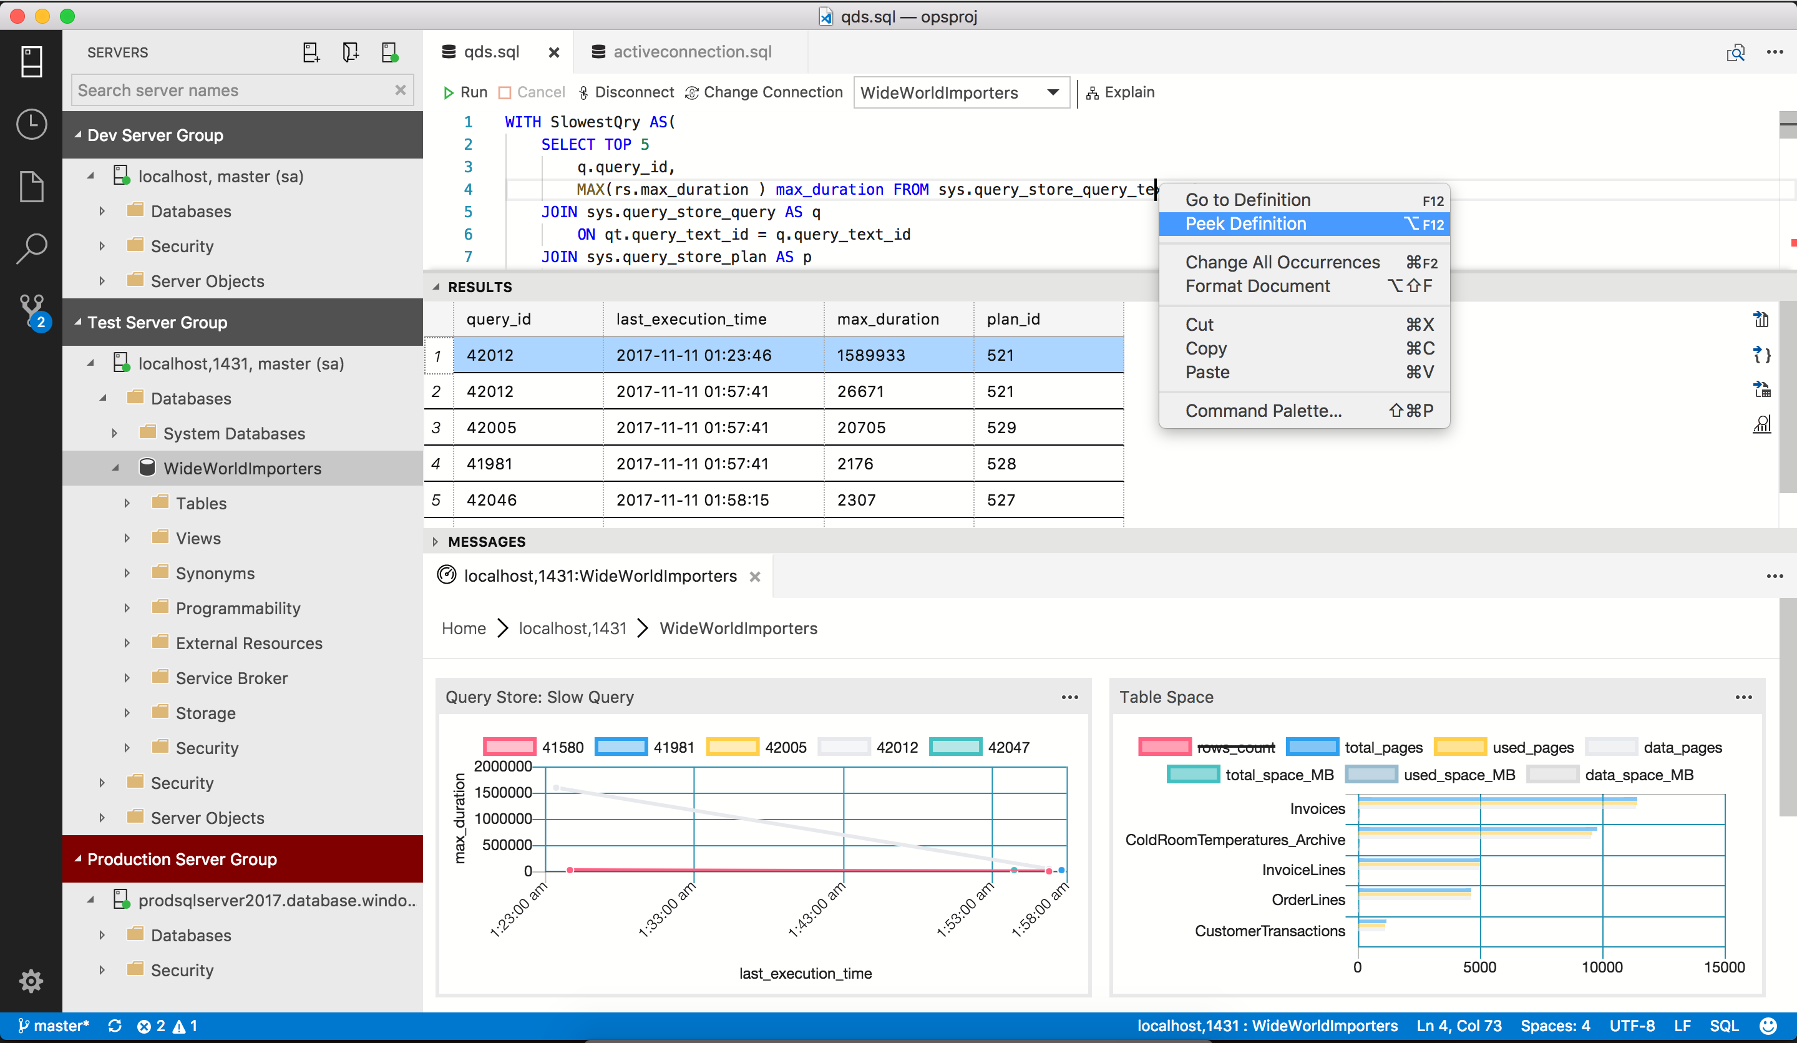
NEW
SQL Operations Studio
Free tool for modern database operations
Runs on Windows, MacOS, and Linux
Supports SQL Server, Azure SQL Database, Azure SQL Data Warehouse

Slide 44





Azure SQL Database
SQL Database
SQL Database
SQL Database
SQL Server as a Service
Azure Database Migration Service
Seamless, near-zero downtime migration
SQL Server
SQL Server
Intelligent, fast, durable

Slide 45
Migrating existing SQL Server
Lara Rubbelke
@sqlgal

Slide 46
PREVIEW
Azure Database Migration Service

Slide 47
MySQL
PostgreSQL
Azure Database for PostgreSQL
Azure Database for MySQL
Built-in high-availability and security
Elastically scale up or down with no application downtime
100% compatible with all existing drivers, libraries, tools

Slide 48
ANNOUNCING
MySQL
PostgreSQL
MariaDB
Azure Database for MariaDB
MariaDB as a Service
Built-in high-availability and security
100% compatible with all existing drivers, libraries, tools

Slide 49

Azure Cosmos DB
The first globally distributed, multi-model database service

Slide 50

Azure Cosmos DB
Globally distributed database service

Slide 51

Azure Cosmos DB
Scale to any need
Gigabytes of data
Petabytes of data
Hundreds transactions / second
Millions of transactions / second

Slide 52
Azure Cosmos DB
Only database with comprehensive SLAs across 4 dimensions
Microsoft Azure
High Availability
Performance Latency
Performance Throughput
Data Consistency

Slide 53
Azure Cosmos DB APIs
MongoDB
DocumentDB
Table storage
Gremlin Graph
Spark
Cassandra
NEW

Slide 54
Artificial Intelligence

Slide 55






Azure SQL Data Warehouse
Azure Cosmos DB
Azure SQL DB
Data-driven Intelligence
Azure Machine Learning
Azure Cognitive Services
Azure Bot Service

Slide 56

NEW
Azure Databricks
Apache® Spark™ based analytics platform optimized for Azure
Quickly launch and scale on demand
Rich interactive workspace
Integrated with Azure Active Directory, Power BI, SQL Data Warehouse, Cosmos DB and Azure Machine Learning

Slide 57
Databricks
Ali Ghodsi
Greg Owen
Co-founder + CEO Databricks
Software Developer Databricks
@alighodsi
@gregorygowen

Slide 58
PREVIEW NOW
Azure Databricks
Apache® Spark™ based analytics platform optimized for Azure
Quickly launch and scale on demand
Rich interactive workspace
Integrated with Azure Active Directory, Power BI, SQL Data Warehouse, Azure Cosmos DB and Azure Machine Learning

Slide 59
Mobile Containers
DevOps
Data
AI
Intelligent Edge + Intelligent Cloud

Slide 60
The Visual Studio Family
Microsoft Azure
Best-in-class tools for every developer

Slide 61
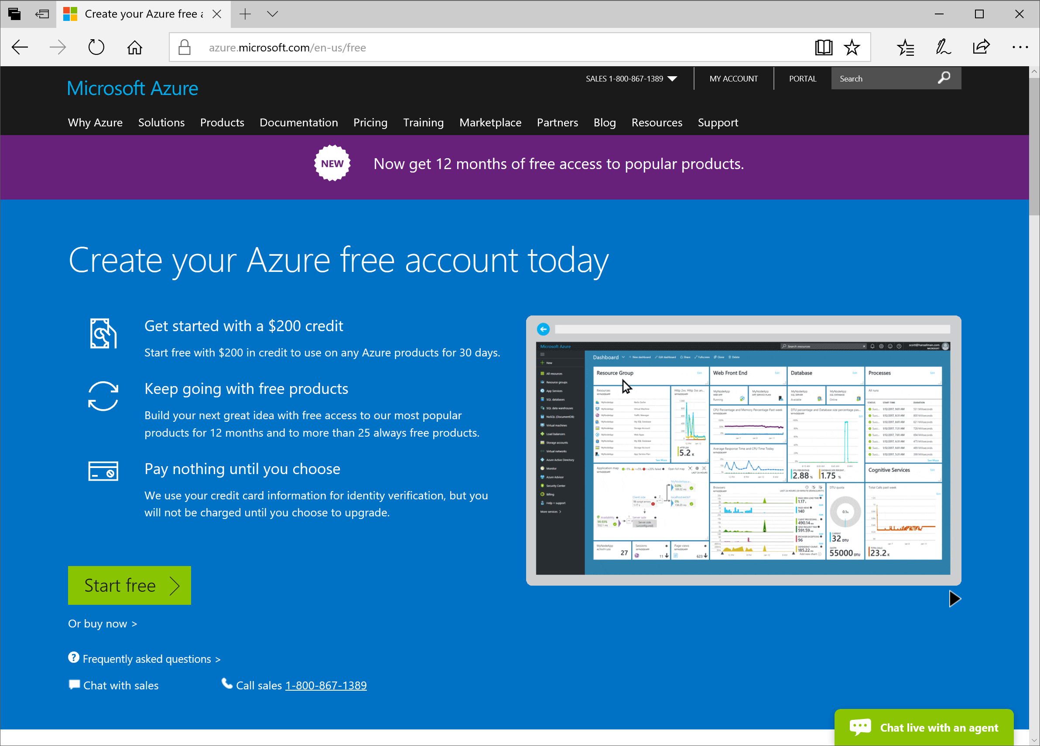
Azure Free Trial
$200 free credits
+
1 year free:
Windows VM
Linux VM
SQL Database
Cosmos DB

Slide 62
Microsoft
Developers

